Slide 1
Augmented Reality based Interactive Text Book
An Assistive Technology for Students with
Learning Disability
Vinumol K.P Ashsish Chowdhury Radhika Kambam V.Muralidharan
Center for Development of Advanced Computing, Hyderabad, India
2013
Muhammad Taufiqulsa’di 16-053
Andika Andra 16-058
Elvega Dewangga 16-149

Slide 2
Abstract
Statistics based on research reveals that India has approximately ninety million people with varying degrees of Learning Disabilities (LD) and an average class in schools has about five students with learning disabilities

Slide 3
Augmented Reality (AR) is a variation of Virtual Environments (VE), or Virtual Reality as it is more commonly called. VE technologies completely immerse a user inside a synthetic environment. In contrast, AR allows the user to see the real world, with virtual objects superimposed upon or composite with the real world
The concept of Learning Disability (LD) includes: children who could see and hear and who do not have marked intellectual deficits, but who show deviations in behaviour and in psychological development to such an extent that they are unable to adjust in home or to learn by ordinary methods in school

Slide 4
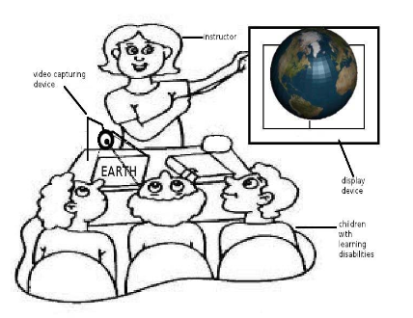
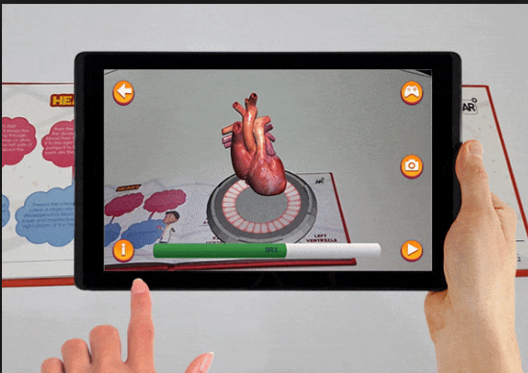
Prototype
Sumber:
Augmented Reality based Interactive Text Book,An Assistive Technology
for Students with Learning Disability, 2013
Sumber:
https://www.vrfocus.com/2017/11/ar-education-book-100-funded-by-kickstarter/

Slide 5
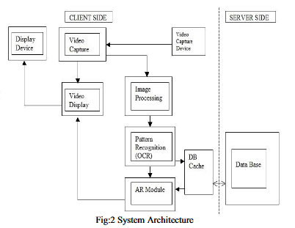
Architecture

Slide 6
Tesseract OCR
Tesseract as provided by Google, takes as input a TIFF image and outputs text

Slide 7
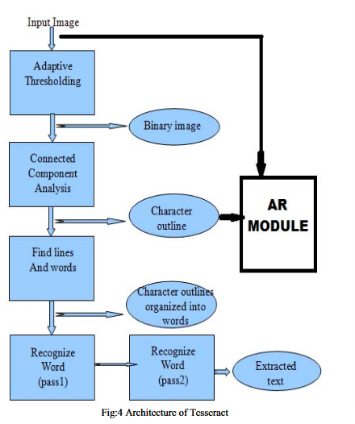
Architecture
Tesseract OCR

Slide 8
Conclusion
Educating students with learning disability is a challenge. Due
to their limited attention span they get easily distracted. A
learning technology that can simulate their interest and catch
their attention is needed to ensure an effective learning
session.

